Slide 1
Building a Mutex with Python is easy – let’s try some examples

Slide 2
Sections
Basic Mutex without events
Event/Reactive Programming Paradigm
Using Events with Mutex
Semaphore

Slide 3
What is a Mutex and what is its basic algorithm (non-exact)?
Staring with a Review

Slide 4
Version 1: Simple and Pure!
#within thread while mutex_locked(): sleep(5) mutex.acquire() # critical section
mutex.release()

Slide 5
Version 2: Spin Lock!
#within thread while check_condition: continue mutex.acquire() # critical section
mutex.release()

Slide 6
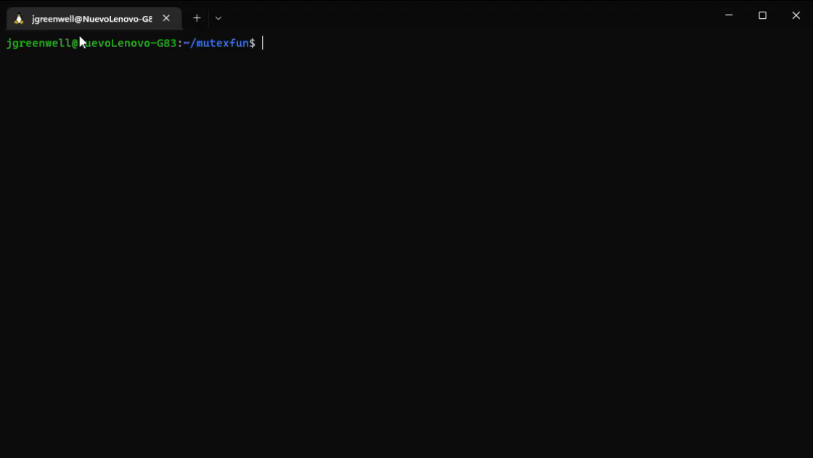
So let’s build the first one: how do I make it a spin lock?

Slide 7
What’s reactive programming & this sub paradigm: Event-based?
Reactive programming is a paradigm that focuses on reacting to data changes:
So a class with “getValues” method and perform some task when the values returned changes.
Event based programming is a sub-paradigm of this that: (well, what do you think?):
Is based on an event, including:
GUI events (clicks, on-mouse-over, on-focus, tab-events, etc)
Signal Processing Events (Audio, camera, GPS/Gyroscope change)
Device Drivers (USB ports rather famously)
We’ve already used an event – do you know what it was?

Slide 8
Event based programming can call for a special design pattern called “MVC”
MVC = Model-View-Controller (look at the first JavaFX program you made – which of these do you see?)
What do you think the View is?
Correct it is the UI (the visual part of the program)
In this case the XML & CSS files
How about the controls & models?
Controller acts as an interface between View and Model. Controller intercepts all the incoming requests.
Model represents the state of the application i.e. data. It may have business logic.

Slide 9
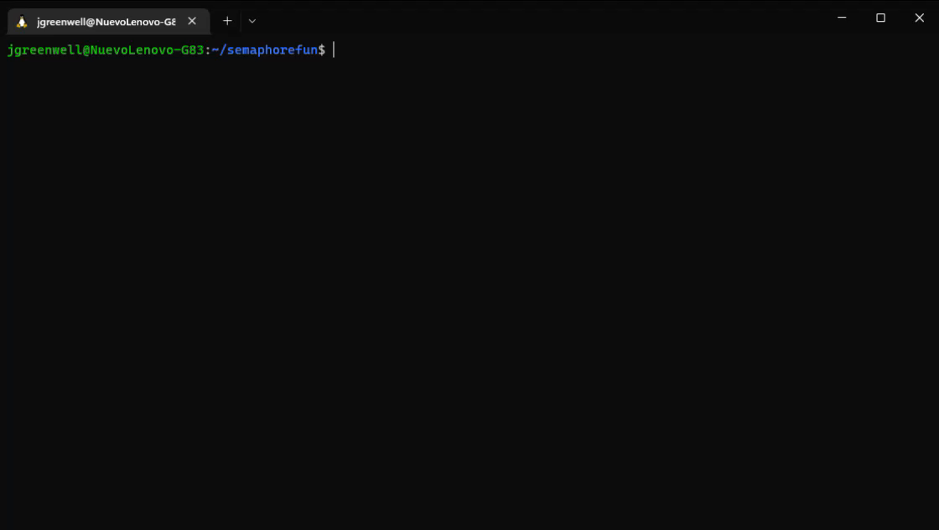
So let’s edit and add an event

Slide 10
https://superfastpython.com/thread-semaphore/
Using with over while True: https://stackoverflow.com/a/48970754/4667934
To explain semaphore (bash) https://www.howtogeek.com/devops/how-to-create-a-semaphore-in-bash/
Using asyncio semaphore: https://stackoverflow.com/a/64365795/4667934
A semaphore: https://www.bogotobogo.com/python/Multithread/python_multithreading_Synchronization_Semaphore_Objects_Thread_Pool.php
Powerpoint on this ©: https://courses.engr.illinois.edu/cs241/sp2012/lectures/23-inside_sem.pdf

Slide 11
Now: Homework is trying those with Reading and Appending

